Slide 1
Full C# by Fakhr
Zero to hero

Slide 2
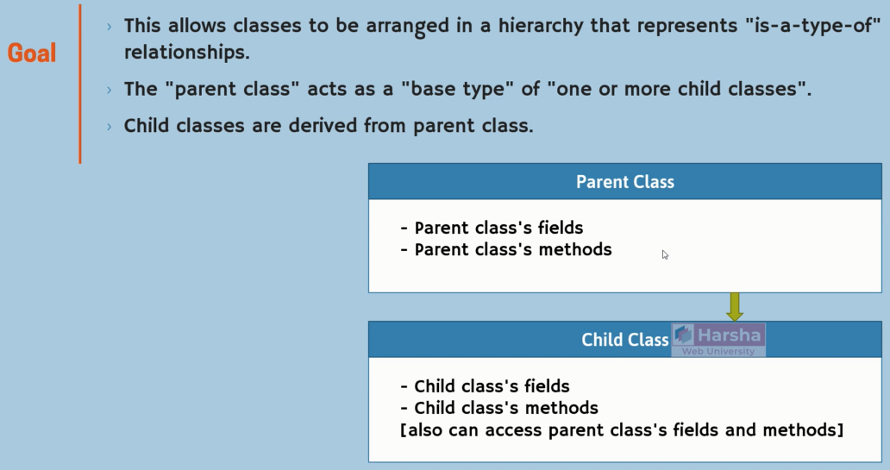
OOP – creating a class – inheritance

Slide 3
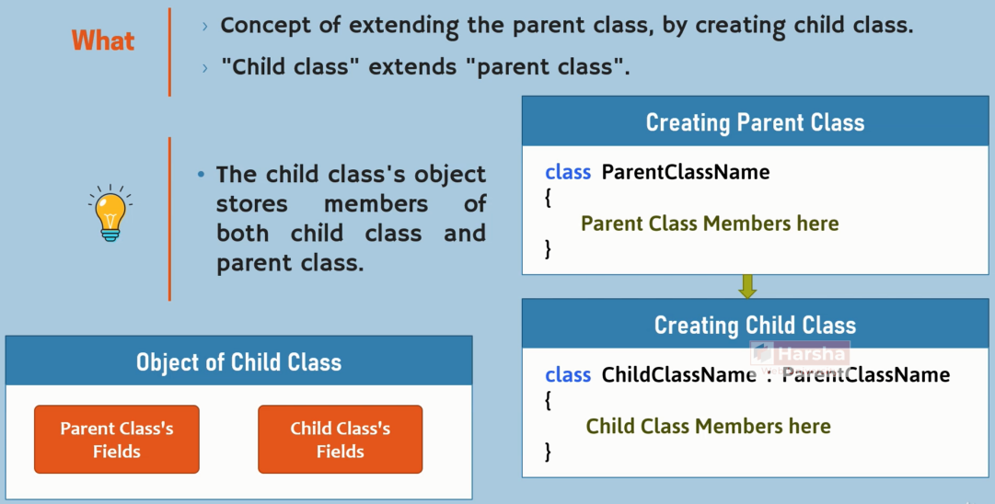
OOP – creating a class – inheritance

Slide 4
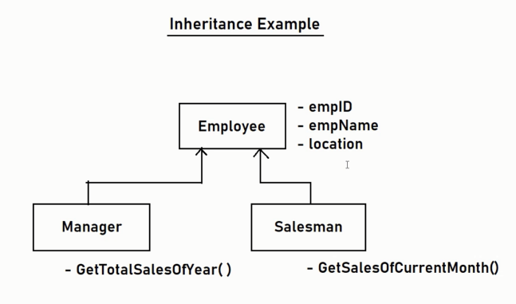
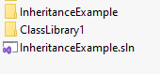
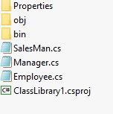
OOP – creating a class – inheritance

Slide 5
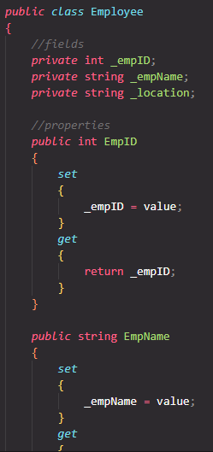
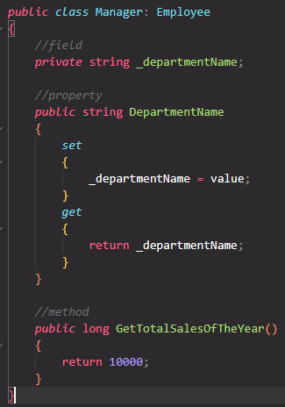
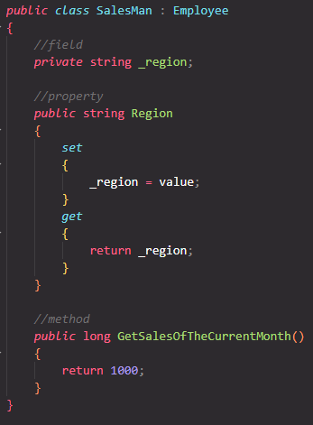
OOP – creating a class – inheritance

Slide 6
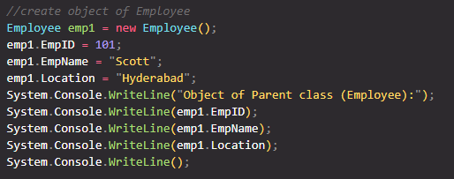
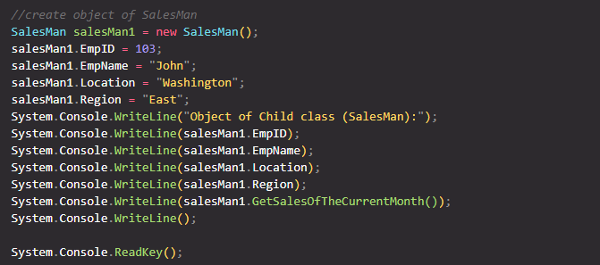
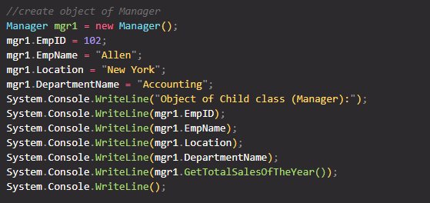
OOP – creating a class – inheritance

Slide 7
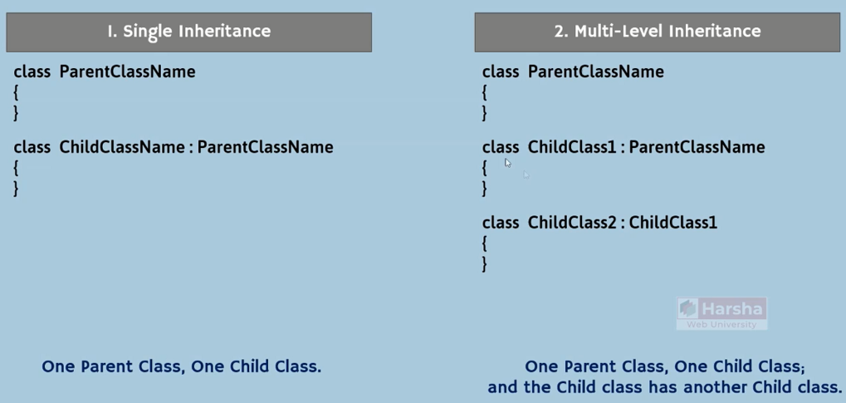
OOP – creating a class – inheritance

Slide 8
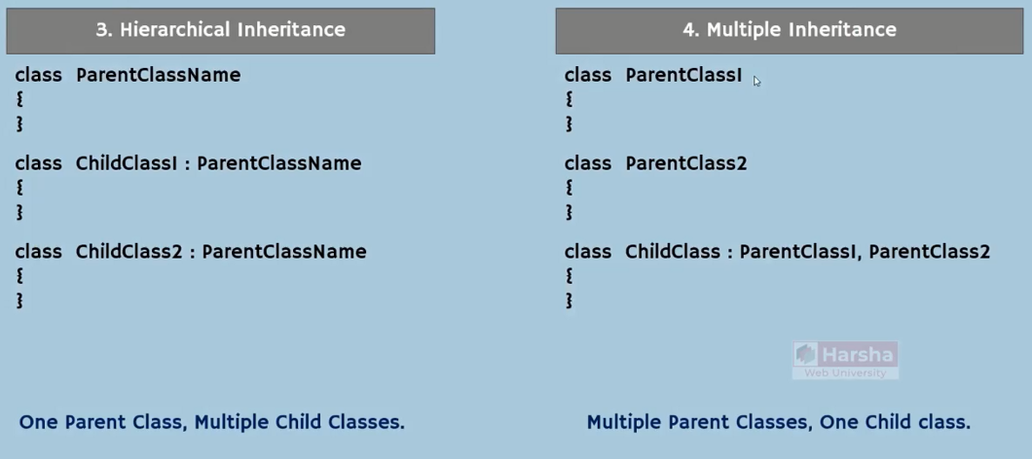
OOP – creating a class – inheritance

Slide 9
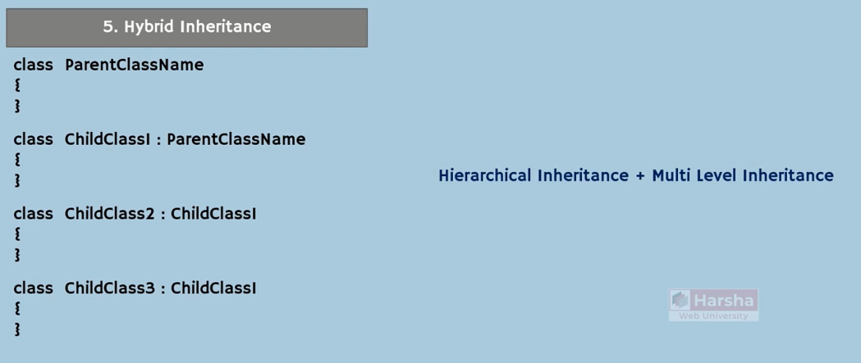
OOP – creating a class – inheritance

Slide 10
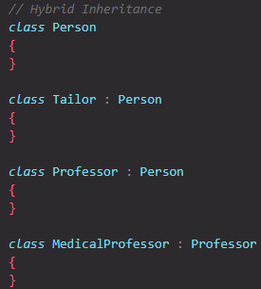
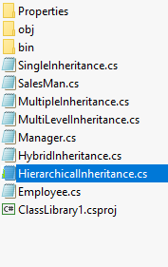
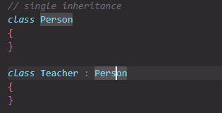
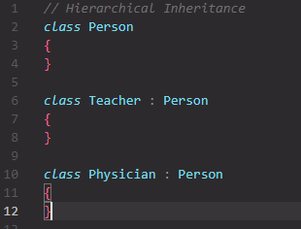
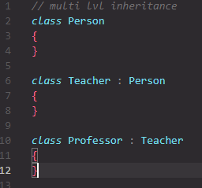
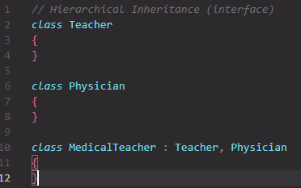
OOP – creating a class – inheritance

Slide 11
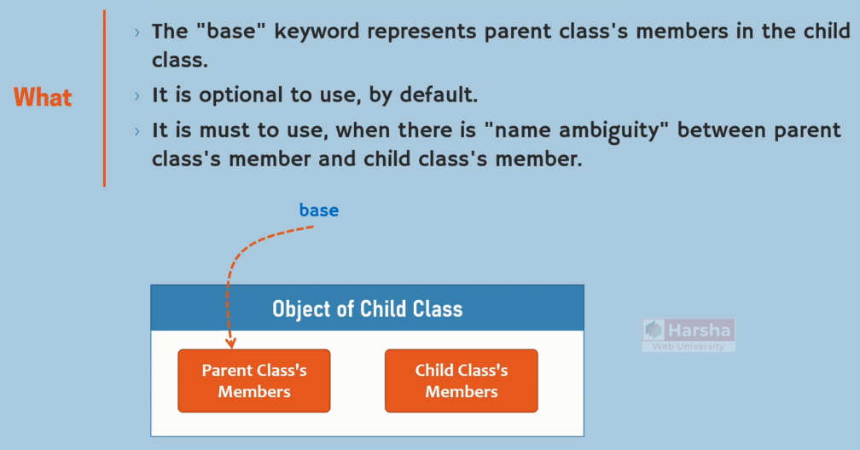
OOP – creating a class – inheritance - base

Slide 12
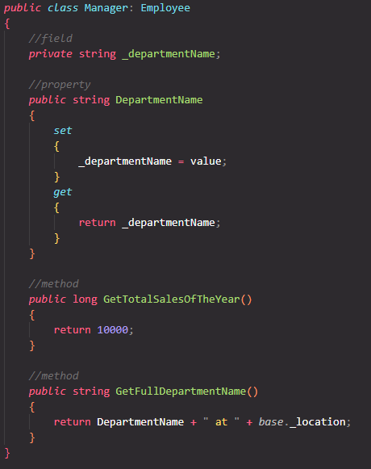
OOP – creating a class – inheritance - base

Slide 13
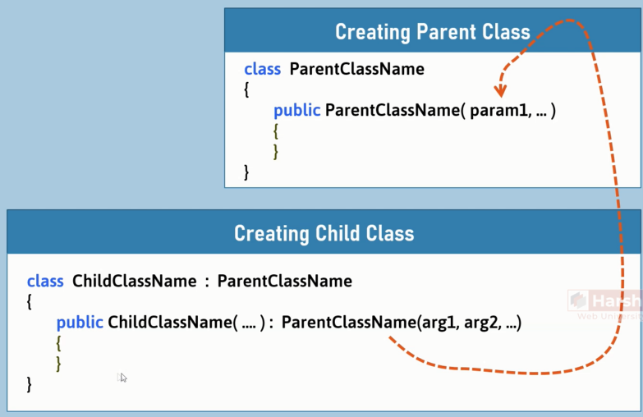
OOP – creating a class – inheritance

Slide 14
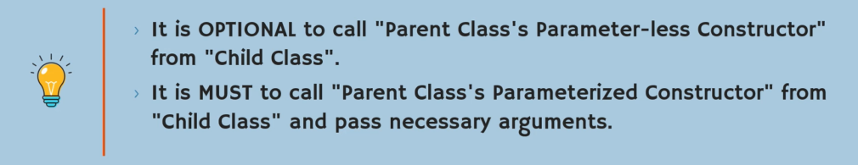
OOP – creating a class – inheritance

Slide 15
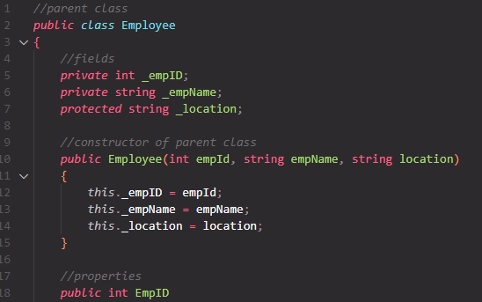
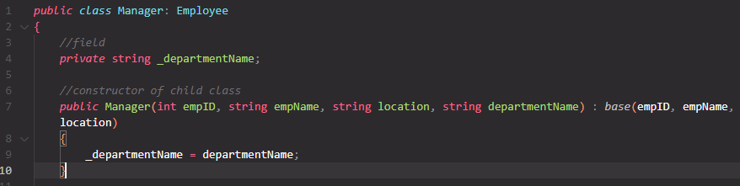
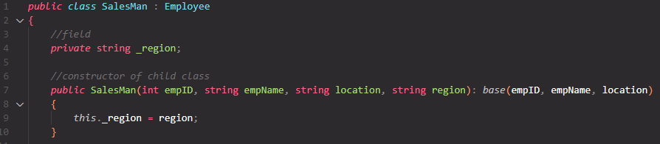
OOP – creating a class – inheritance

Slide 16
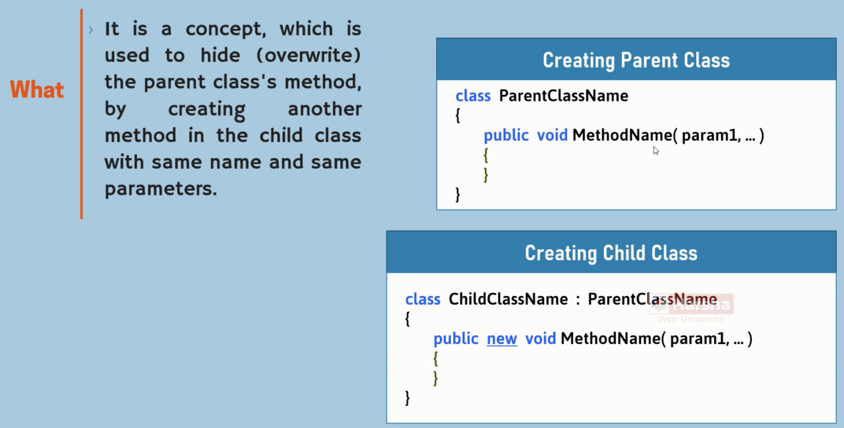
OOP – creating a class – inheritance- overwrite

Slide 17
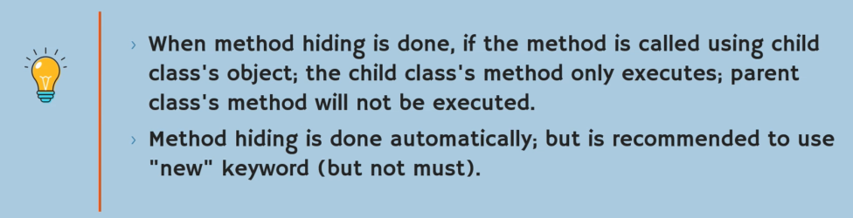
OOP – creating a class – inheritance- overwrite

Slide 18
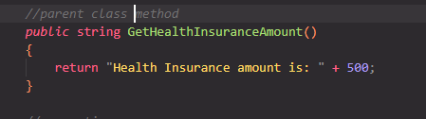
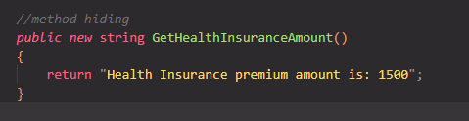
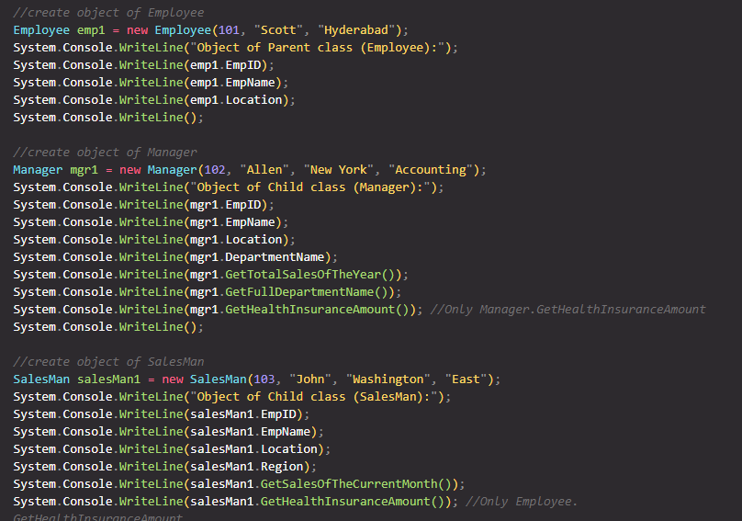
OOP – creating a class – inheritance- overwrite

Slide 19
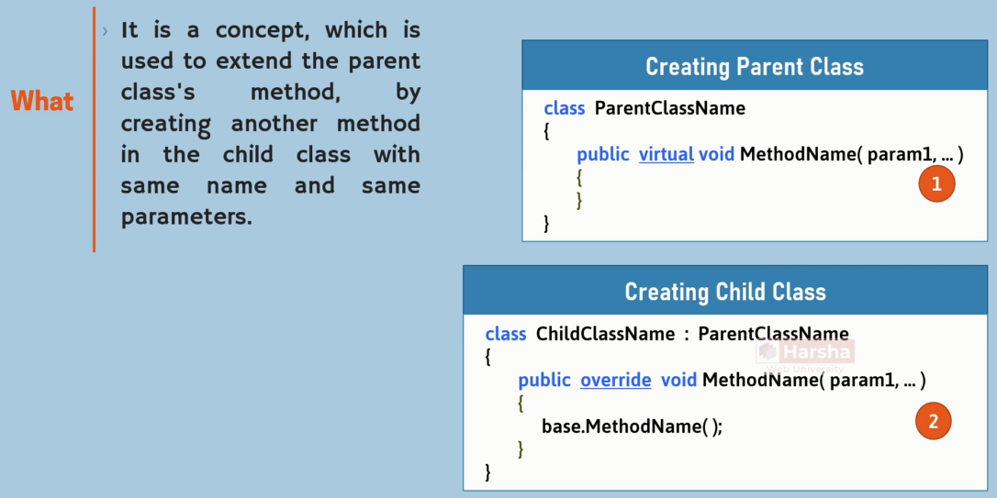
OOP – creating a class – inheritance- overriding

Slide 20
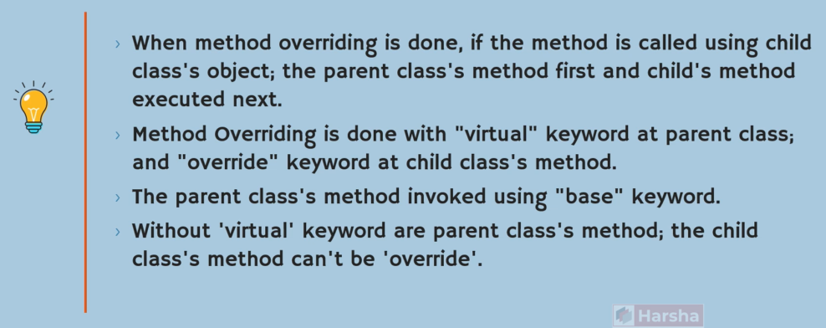
OOP – creating a class – inheritance- overriding

Slide 21
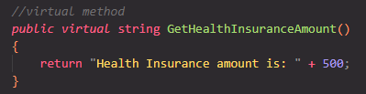
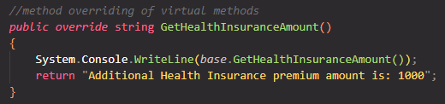
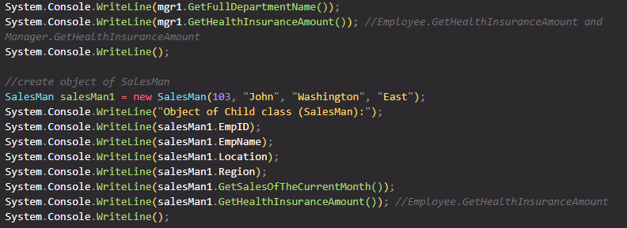
OOP – creating a class – inheritance- overriding

Slide 22
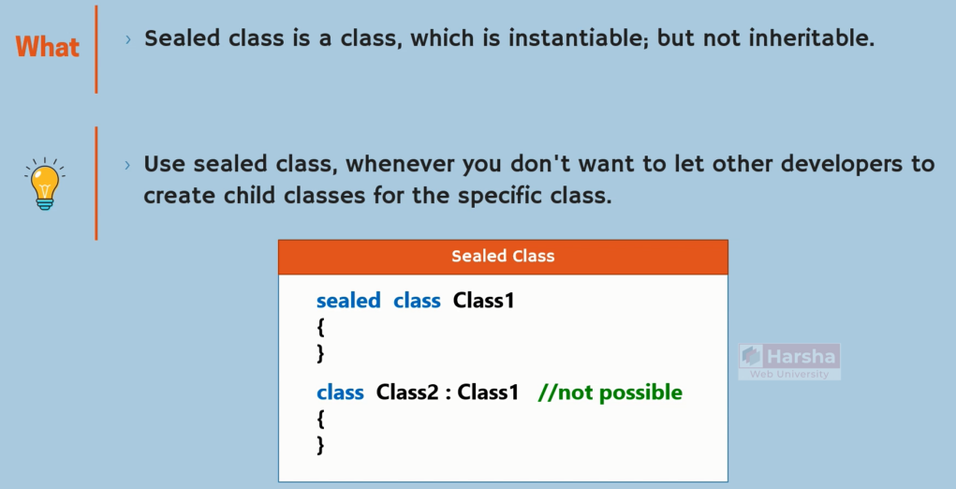
OOP – creating a class – inheritance - sealed

Slide 23
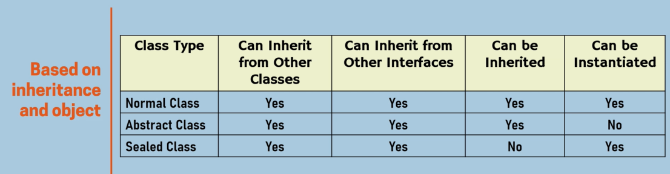
OOP – creating a class – inheritance - sealed

Slide 24
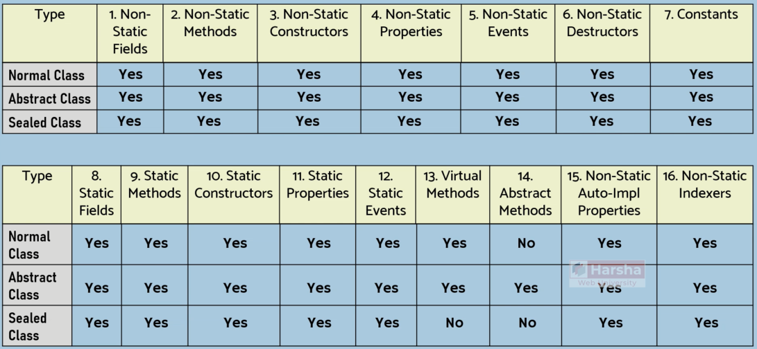
OOP – creating a class – inheritance - sealed

Slide 25
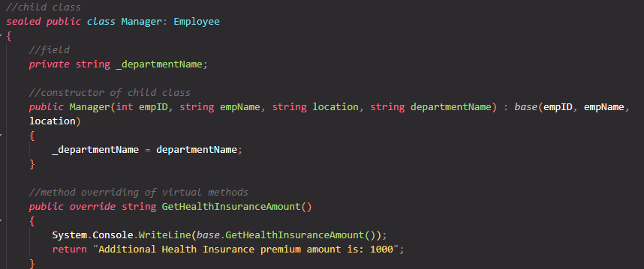
OOP – creating a class – inheritance - sealed

Slide 26
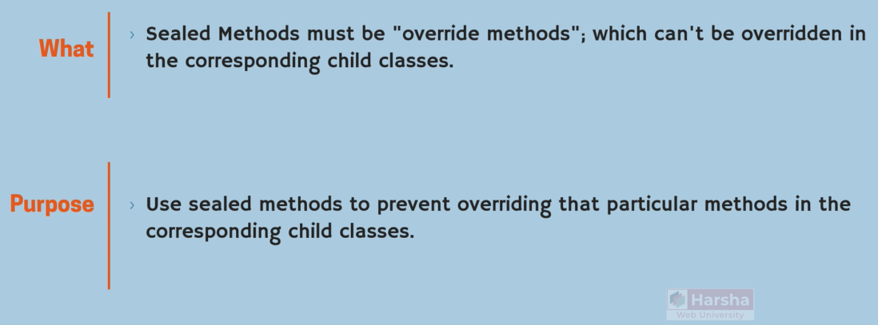
OOP – creating a class – inheritance - sealed

Slide 27
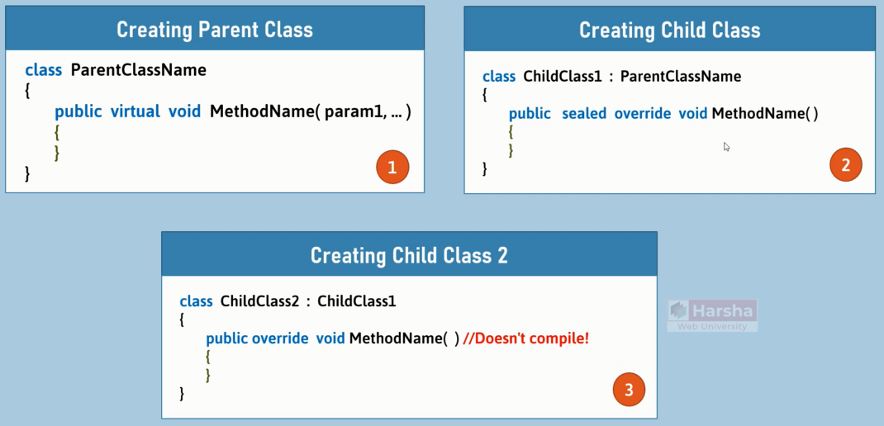
OOP – creating a class – inheritance - sealed

Slide 28
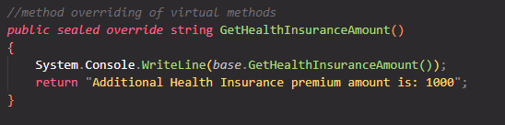
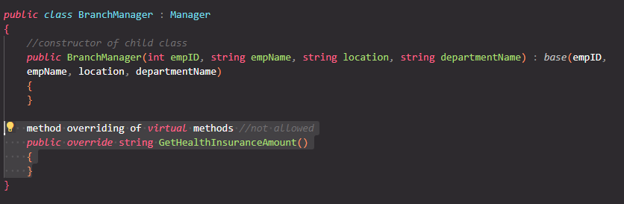
OOP – creating a class – inheritance - sealed

Slide 29
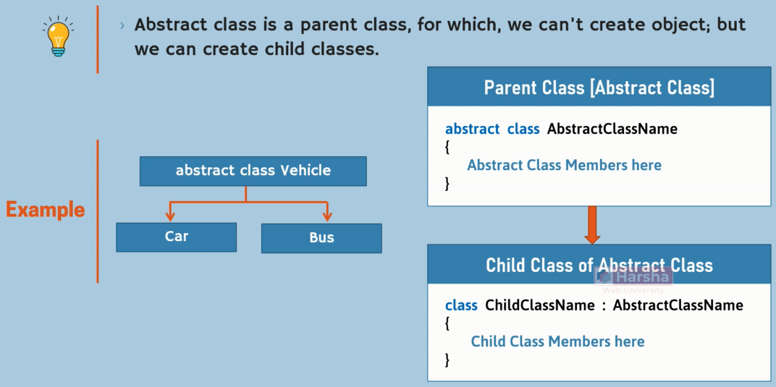
OOP – creating a class – abstract

Slide 30
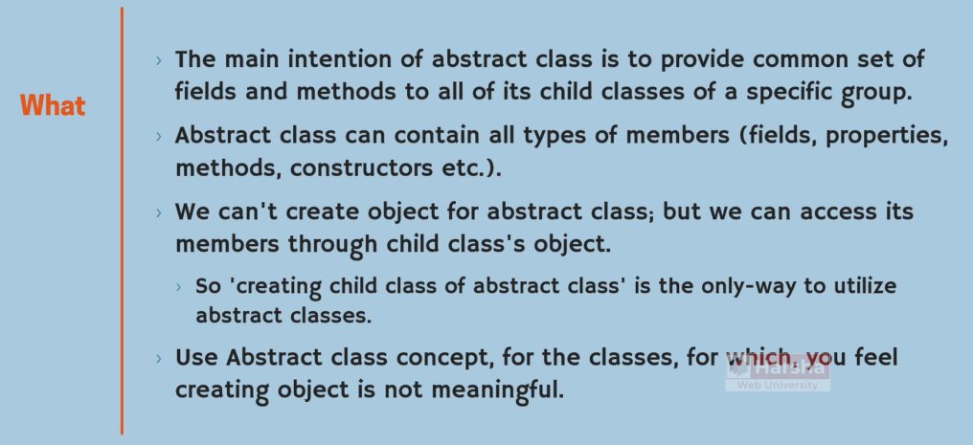
OOP – creating a class – abstract

Slide 31
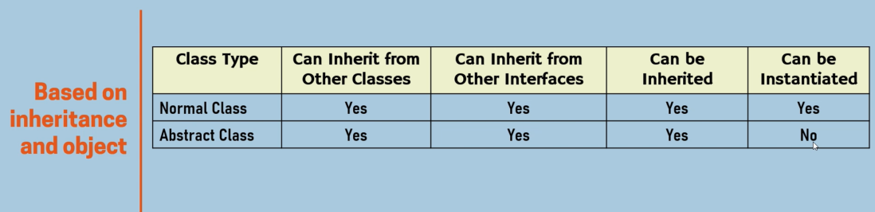
OOP – creating a class – abstract

Slide 32
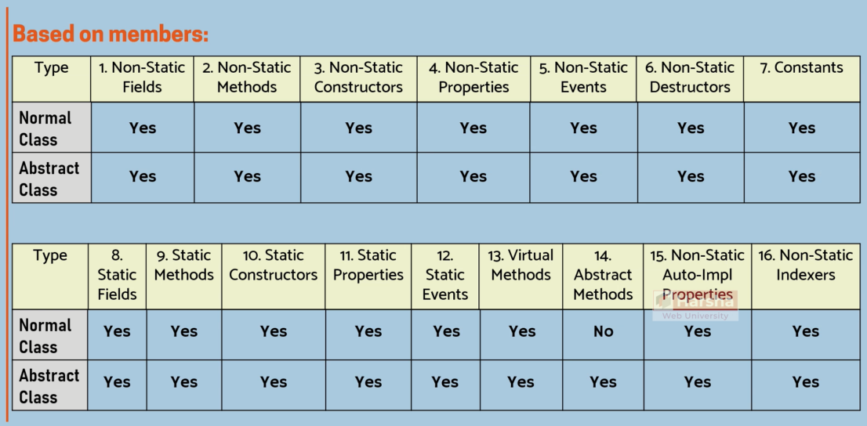
OOP – creating a class – abstract
Notes:
Employee -→ abstract

Slide 33
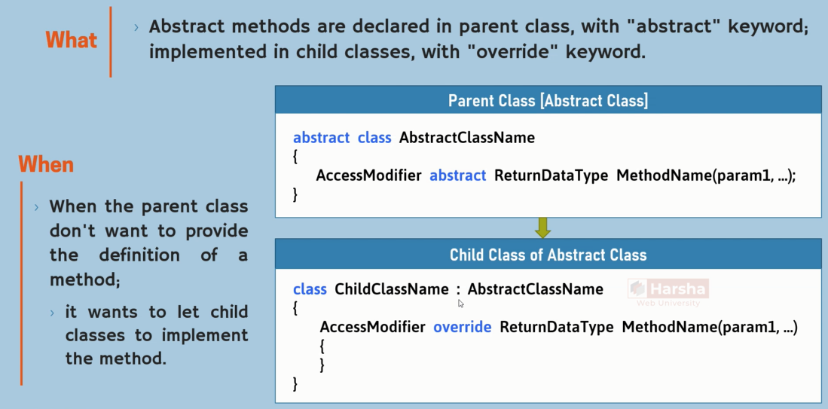
OOP – creating a class – abstract - method

Slide 34

OOP – creating a class – abstract - method

Slide 35

OOP – creating a class – abstract - method

Slide 36


OOP – creating a class – abstract - method

Slide 37

OOP – creating a class – interface

Slide 38

OOP – creating a class – interface

Slide 39


OOP – creating a class – interface

Slide 40


OOP – creating a class – interface

Slide 41


OOP – creating a class – interface

Slide 42

OOP – creating a class – interface

Slide 43

OOP – creating a class – interface

Slide 44


OOP – creating a class – interface

Slide 45


OOP – creating a class – interface

Slide 46


OOP – creating a class – interface

Slide 47


OOP – creating a class – interface

Slide 48
OOP – creating a class – interface

